Slide 1
Digital Semiconductors Pvt. Ltd.
(International Electronic components Distributor )

Slide 2

Hello world!
I AM
I am here because I can provide you better and fast services.
You can find me at:
sales@digitalsemi.in

Slide 3
1
Whole seller Distributor, OEM’s Supplier
Let’s start with the first set of slides

Slide 4
Our Promises: Right Quality, On Time Delivery, Best Value, Innovation, Sustainability
Digital Semiconductors Pvt. Ltd. New Millennium and since then has been one of the most Successful and Fastest growing Electronic Companies in India.

Slide 5
Meet the Digital Semiconductors PVT. LTD.
Your True Partner in Business Development to Maximize Revenue!

Slide 6
The Services
BUSINESS CONSULTANTS
We enhance our client‘s business worldwide in the energy sectors since 2006. Leading Electronic Components Seller in India. Fastest Delivery of Electronic Components in all over India.
WE ALSO DO KITTING
We have technical expertise to provide product solution, alternative parts in better prices and availability. We provide parts on time with good prices. We have huge stock of electronic components at Singapore / USA / Hong Kong etc.
BEST SUPPLY CHAIN MANaGEMENT
Our SCM approach enhances the efficiency of courses connected with obtaining goods and services, processing materials and managing inventory.
OUR STRATEGY
A product is something made in a factory; a brand is something that is bought by the customer. A product can be copied by a competitor; a brand is unique. A product can be quickly outdated; a successful brand is timeless.

Slide 7
Why Us?
We have been able to gain a remarkable position in the industry with supply best quality parts to our clients.
We are reliable and are preferred the choice
of our patrons due to the
following reasons:
Qualitative range
Timely deliveries
Ability to handle bulk orders
Cost effectiveness of the entire range
Ethical business policies
We have Rich and trustworthy base
Why Us

Slide 8
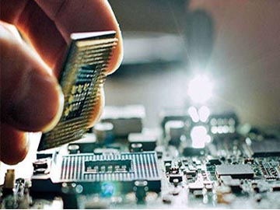
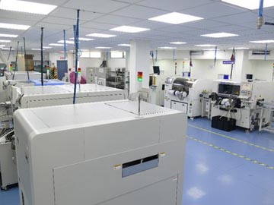

Core Services
Electronics Components Distribution
Contract Manufacturing
Lighting Division

Slide 9



Brand We Are Dealing With

Slide 10
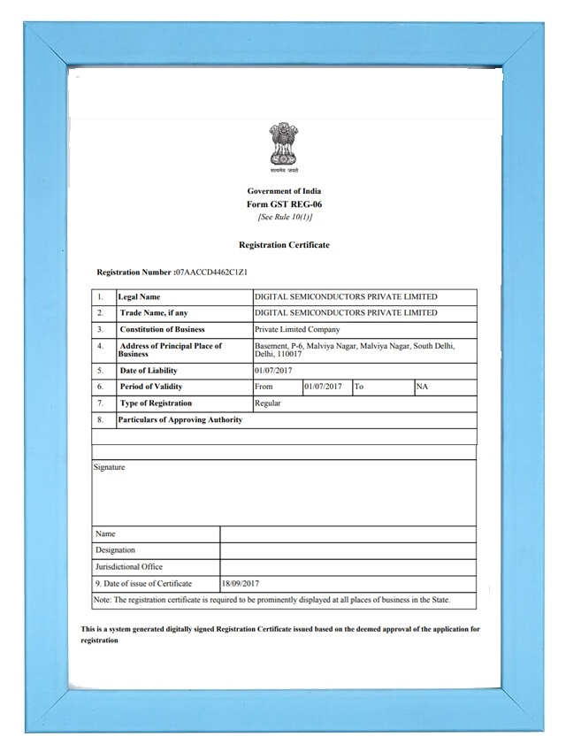
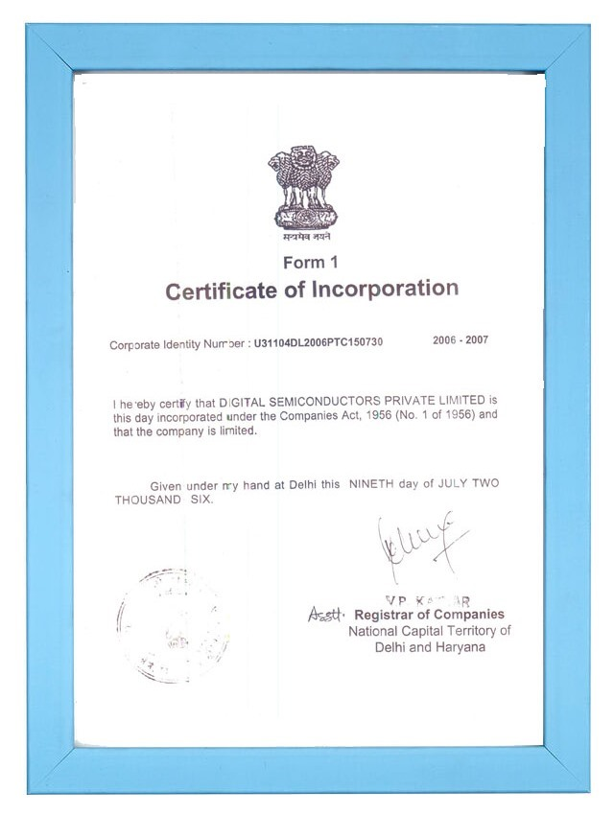
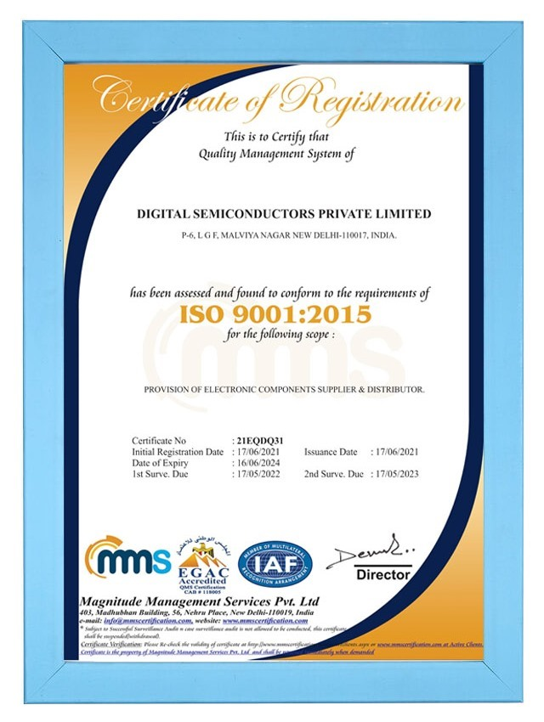
Company Documents

Slide 11
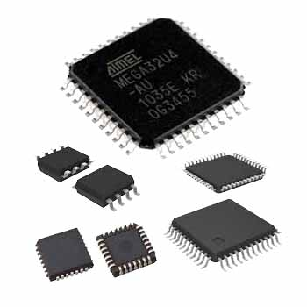
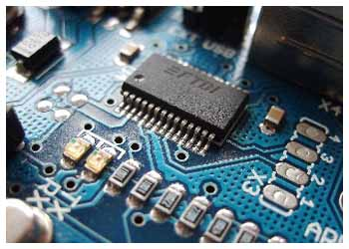
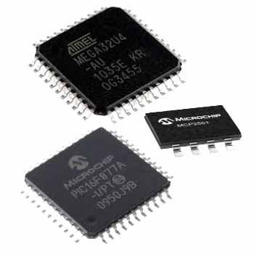
Product We Deals In
ICs

Slide 12
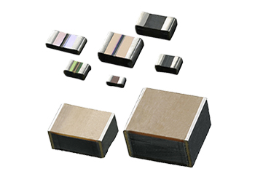
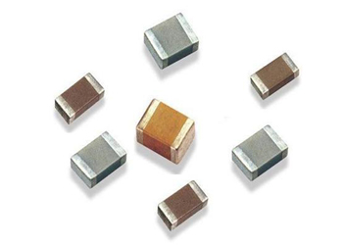
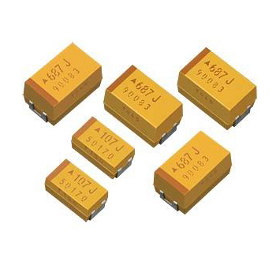
SMD CAPACITORS

Slide 13
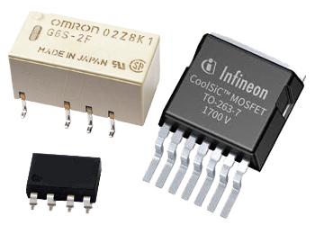
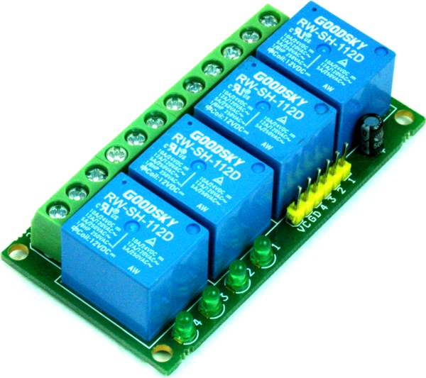
SMD RELAYS

Slide 14
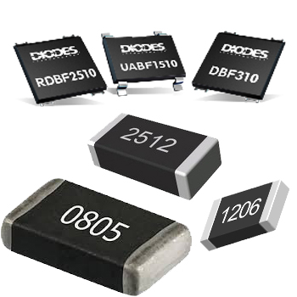
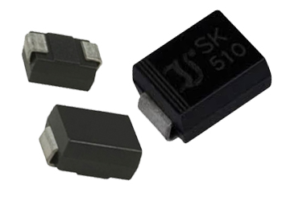
SMD DIODES & RESISTORS

Slide 15


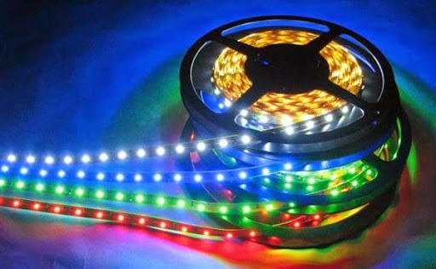
LEDs

Slide 16

ADDRESS Digital Semiconductors Pvt. Ltd.
Office Add: P-6, Basement Malviya Nagar. New Delhi-110017
Phone: 7011-457-633 +91-9810-257-888
Phone: 011-41040285 / 011-26686377
Office Location
Click Now
Scan QR Code Get Company Details Your Device

Slide 17
Thanks!
ANY QUESTIONS?
You can find me at:
WWW.DIGITALSEMI.IN
INFO@DIGITALSEMI.IN
SALES@DIGITALSEMI.IN

